Slide 1
JDRF Illinois Powered By Kids
School Kick Off

Slide 2
WELCOME
Today’s Topics Include
What You Need to Know About T1D
Type 1 v Type 2
What is JDRF?
How can you help?
School Fundraiser
Notes:
Welcome students and staff to the JDRF Illinois: Powered by Kids kickoff!
Today, you are going to learn a little bit about type 1 diabetes or we like to call it T1D, an important organization called JDRF–AND we’ll talk about how all of you can help make a difference for the 1. 6 million people living with T1D today, over 200,000 youth! But all those youth turn into adults eventually.
First, we’re going to watch a video made by kids right here in Illinois, who want to tell you what it’s like to have T1D and why it is important to help JDRF.

Slide 3

What you need to know about T1D
Type 1 Diabetes: What You Need to Know
Notes:
PLAY VIDEO
This video was made at Naperville Central High School.
These actors are JDRF Illinois Youth Ambassadors. They are actually living with T1D.

Slide 4
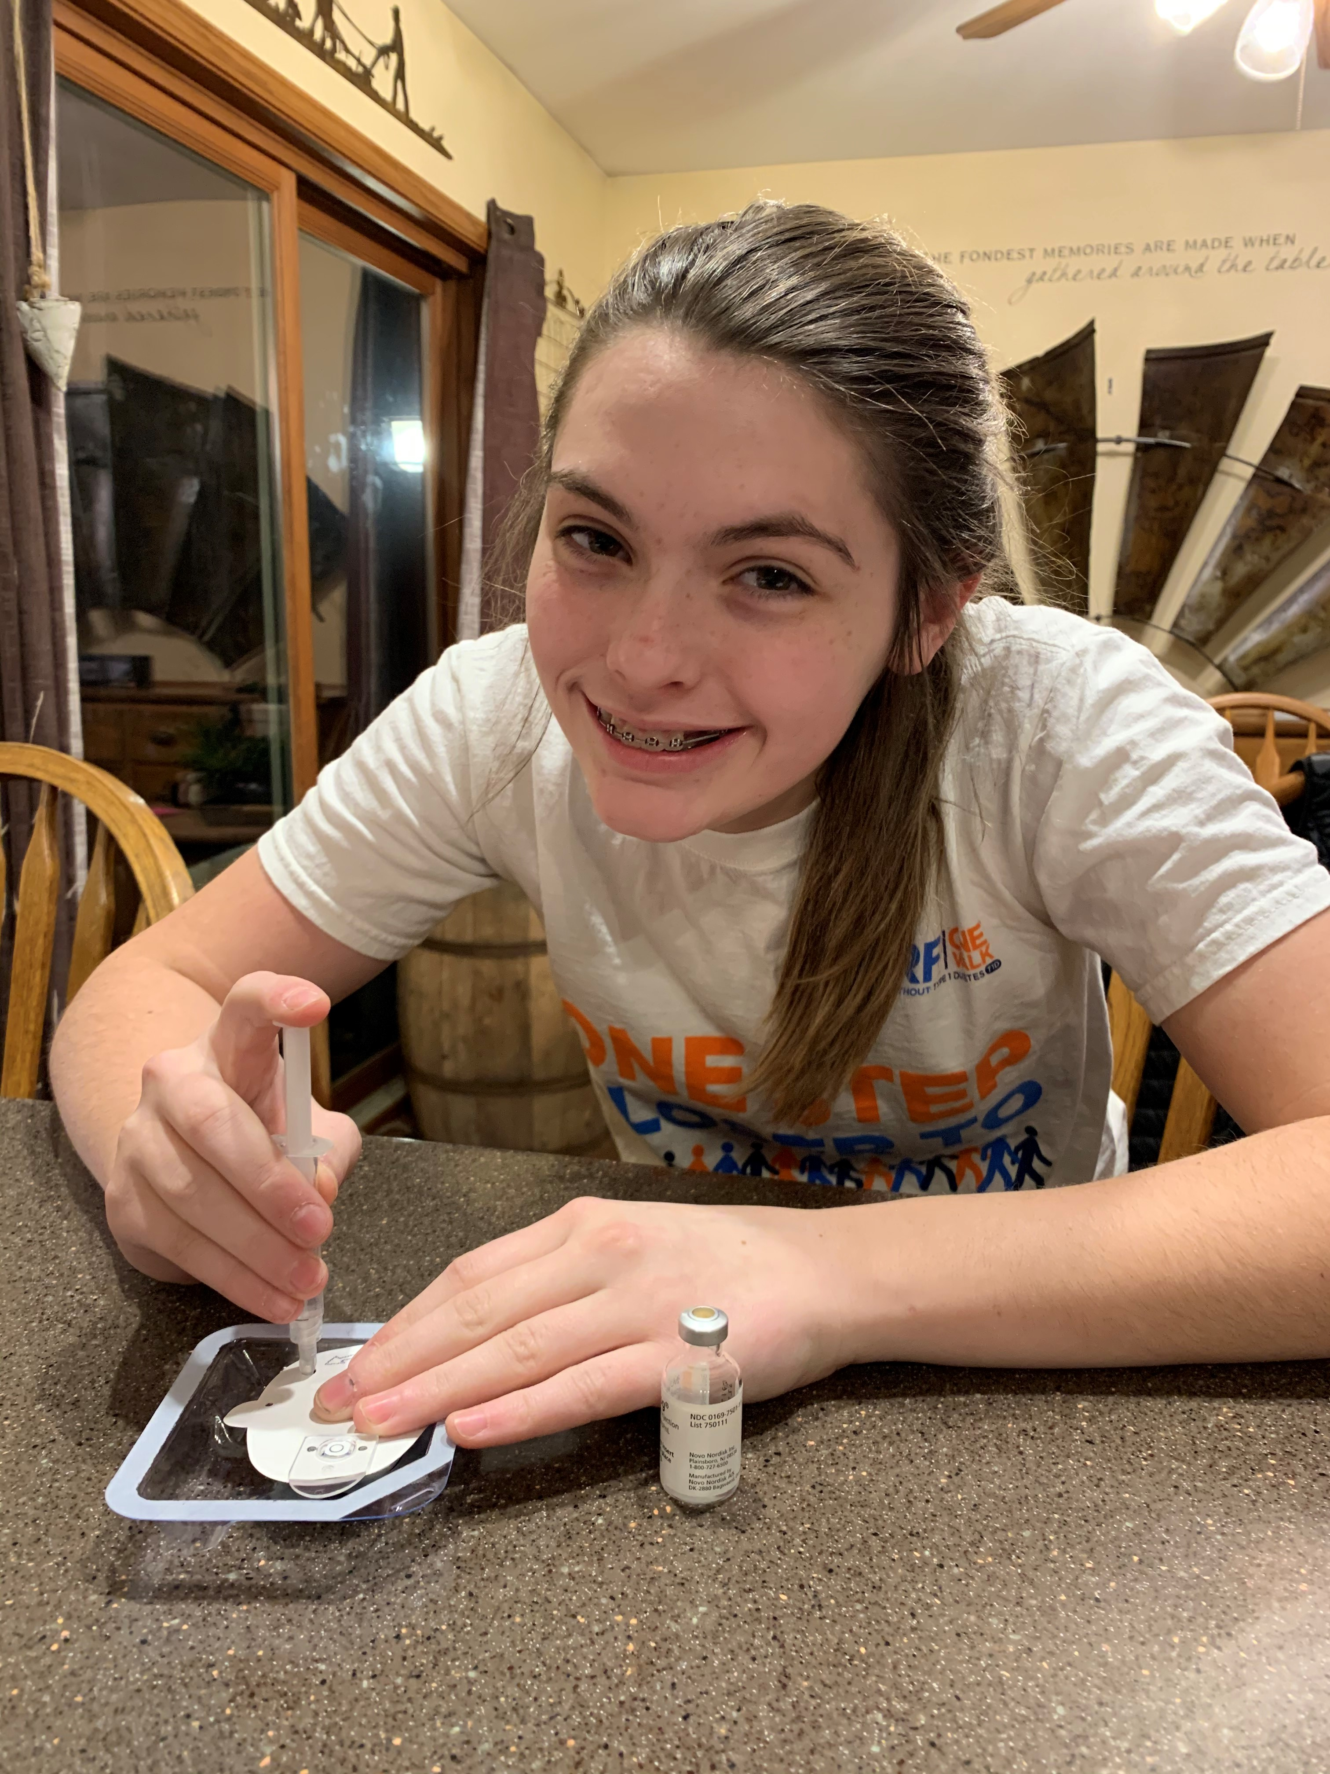

What you need to know about T1D
People with T1D get their insulin from shots or a pump. They must check their blood sugar everyday.
People with type 1 diabetes (T1D) can do anything other people can.
Being diagnosed with T1D is not anyone’s fault and is not contagious.
Treat people with T1D the same as anyone else.
JDRF is here for those with T1D! Until a cure is found, JDRF is helping people with T1D to stay healthy
Notes:
Let’s talk about what we learned:
We learned about the pancreas and a hormone called insulin. Insulin turns our food into energy. People with T1D have to get their insulin from shots or from a pump, each and every day until there is a cure.
People with T1D also have to check their blood sugar by poking their finger many times EVERY day to make sure it isn’t too high or too low. High or low blood sugars can be dangerous and usually, people with T1D don’t feel very well when their blood sugar is high or low.
We learned that people with T1D can do anything other people can do but it takes a lot of hard work to stay healthy. They often need to try to stick to a special routine all day. They always have to have all of their supplies with them including extra supplies and low snacks.
We also learned that is not someone’s fault if they have T1D and that it is NOT contagious. You never have to worry about “catching” diabetes from someone else like you can catch a cold.
It’s important to be a friend to people with diabetes and treat them just like you would treat anyone else.

Slide 5
.
What’s the difference between type 1 and type 2 diabetes?

Slide 6
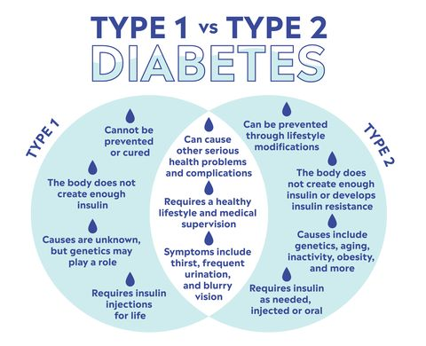
Notes:
Differences between type 1 and type 2 diabetes:
There are two kinds of diabetes–type 1 and type 2. There are many differences between them even though they both have ‘diabetes’ in the name.
Both types of diabetes are NOT contagious
Type 1 Diabetes: is an autoimmune disease. It occurs when the pancreas stops producing a hormone called insulin which helps to control the glucose in the blood stream. It is not preventable and there is no cure yet. It is a full time job for anyone that has been diagnosed with the disease.
Doctors have been able to figure out some of the reasons why people get type 2 diabetes, and they know that sometimes it can be prevented by making healthy choices and getting exercise.
Doctors are still trying to figure out why some people get T1D though.
Remember, it isn’t someone’s fault if they have T1D and you can’t get T1D from eating too much sugar.

Slide 7
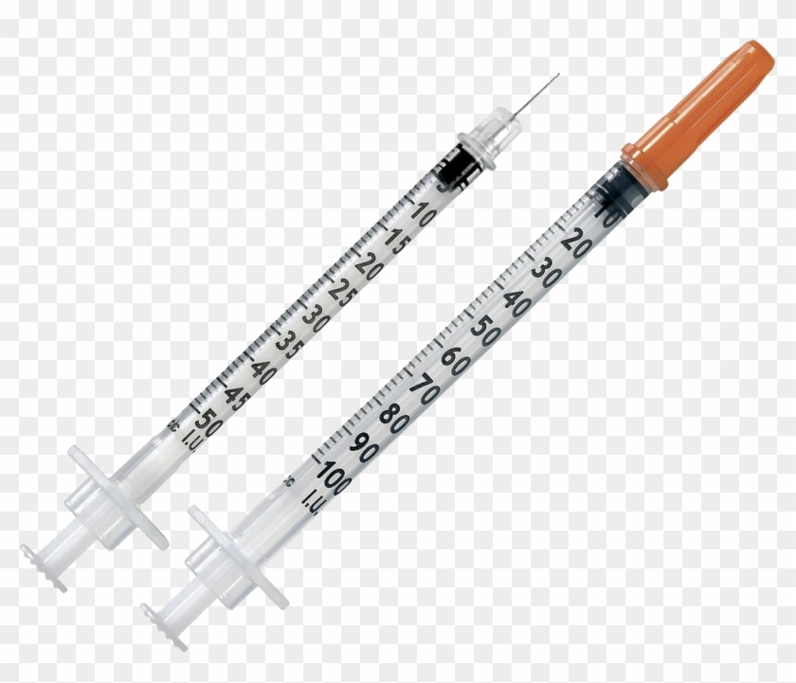
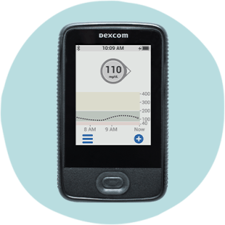
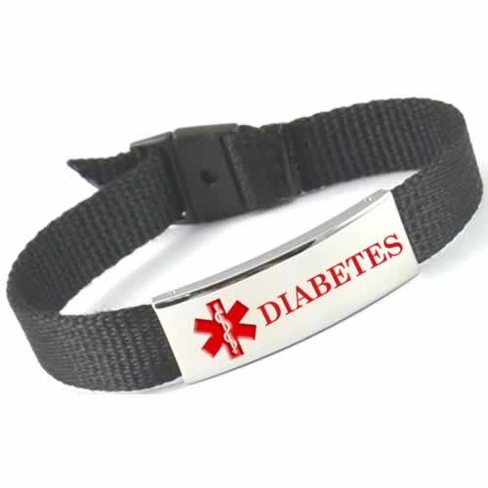

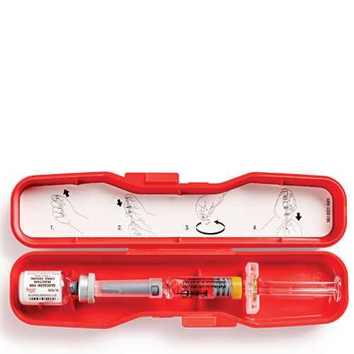
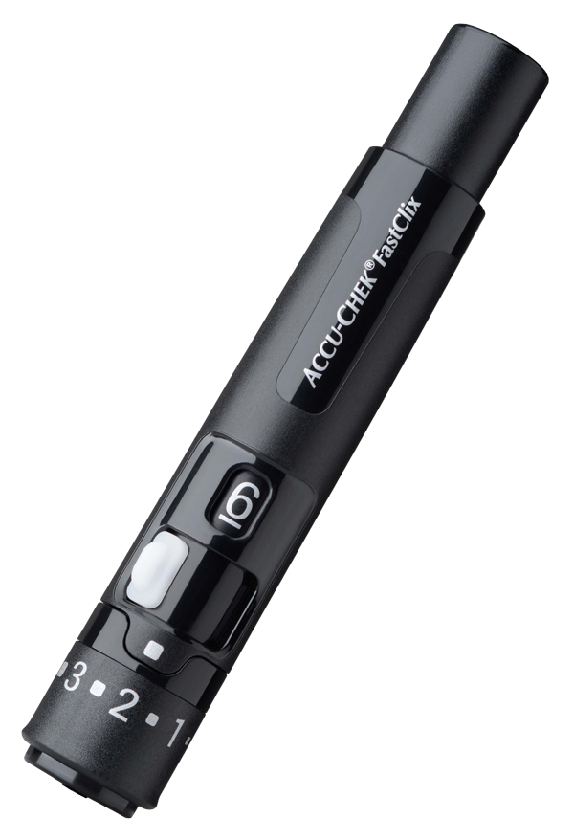
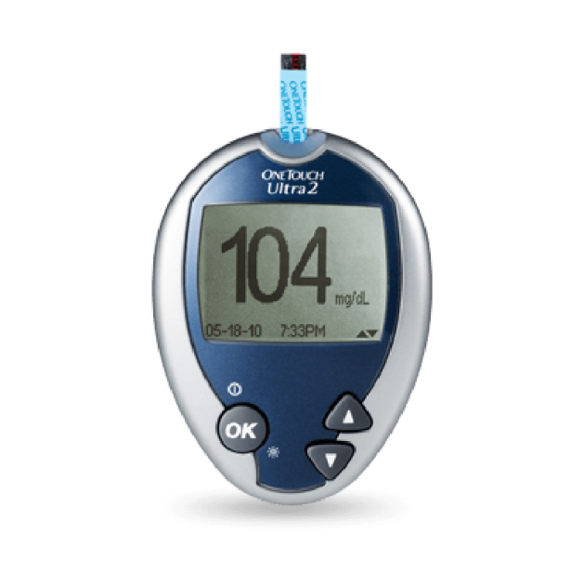
Here’s a list of some supplies a person with T1D might need for school
Insulin Pump, Pens, or Syringes
Continuous Glucose Monitor Receiver or Phone That is Connected
Medical ID
Sugar like Apple Juice, Skittles, or Fruit Snacks
Emergency Glucagon in case of an emergency with Blood Glucose
A Pricker to test Blood Glucose
Blood Glucose Meter

Slide 8


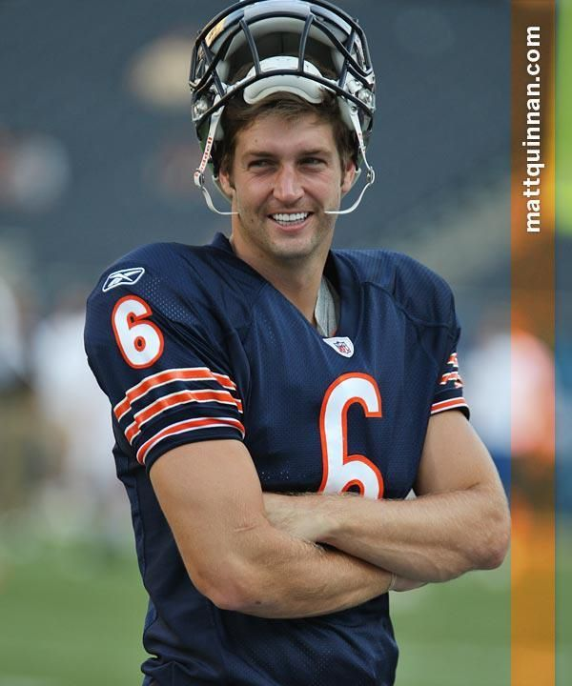

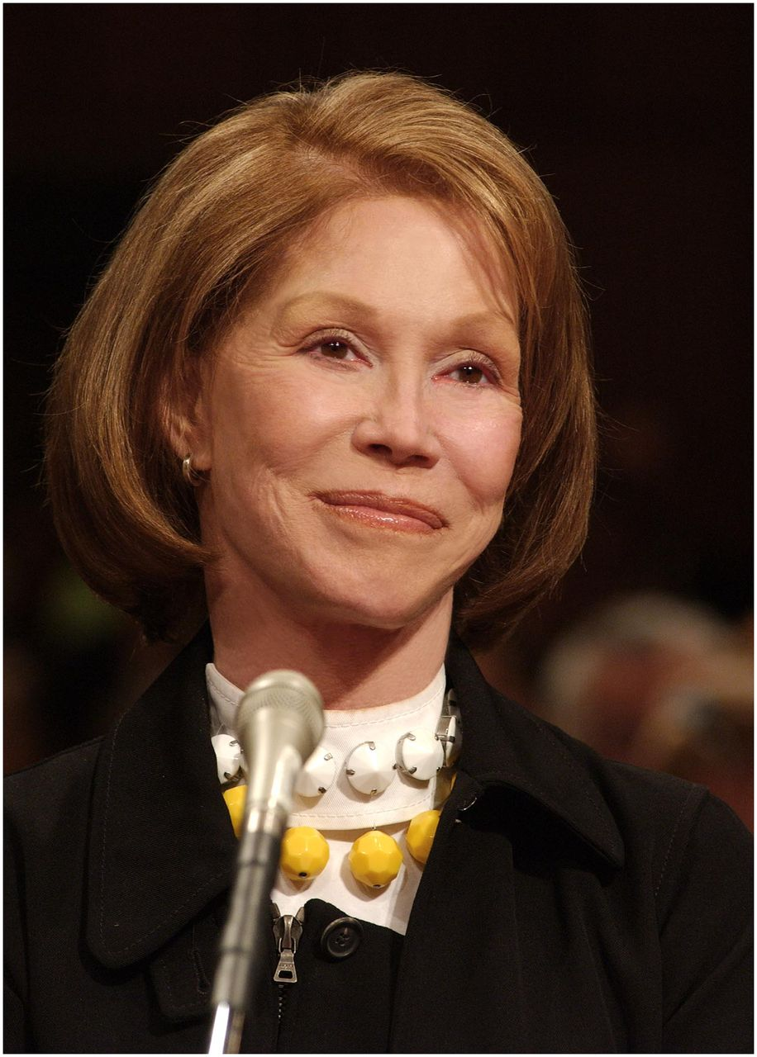
T1D SUPERSTARS
Nick Jonas
Jay Cutler
Brec Bassinger
Mary Tyler Moore
Diagnosed at age 13
Diagnosed at age 25
Diagnosed at age 8
Diagnosed at age 33

Slide 9
What is JDRF?

Slide 10
What is JDRF?
JDRF is the leading organization in the world fundraising for type 1 diabetes.
Vision: A world without type 1 diabetes
Mission: Accelerate life changing breakthroughs to cure, prevent and treat type 1 diabetes and all its complications.
JDRF host lots of events and fundraisers to support those living with type 1 diabetes.
Notes:
JDRF is the leading organization in the world fundraising for type 1 diabetes.
Vision: A world without type 1 diabetes
Mission: Accelerate life changing breakthroughs to cure, prevent and treat type 1 diabetes and all its complications.
JDRF host lots of events and fundraisers to support those living with type 1 diabetes.
JDRF also pushes for increased government funding for research and work to get new therapies and devices to market quickly and safely.

Slide 11
How can you help?
Notes:
Now that you’ve learned a lot about diabetes and JDRF, let’s talk about how YOU can help people with T1D. This is your chance to make a difference.
It’s all about kids helping kids!

Slide 12

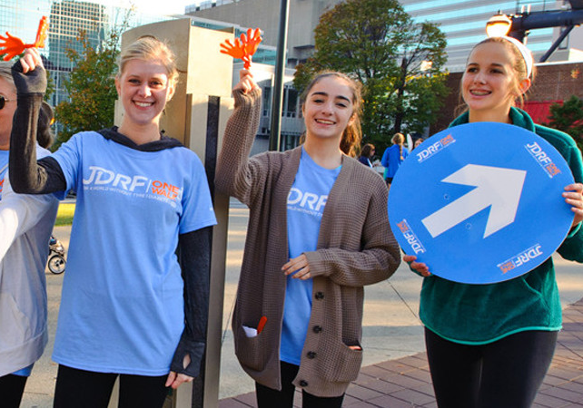
Your School Fundraiser Will Make A Difference!
The money you raise will help fund scientists and doctors to research new technology and cures.
You can have an impact by spreading awareness and helping in the fight against T1D!

Slide 13
School Fundraiser
Notes:
So how can you help?
INSERT SCHOOL FUNDRAISER INFORMATION HERE.

Slide 14

Have fun with your school fundraiser!
Notes:
Thank you for listening today and for all that you are going to do to help in moving diabetes research forward and make this event a huge success!

